Slide 1



Slide 2

Recommendation System for the Purchase Data of the Shopping Arcades
Supervised by:
Sir Bilal Haider Bukhari
Co-Supervised by:
Dr. Saud Khan
Group Members:
Naqash Haider (FA16-BCS-047)
Muhammad Yasir Irfan (FA16-BCS-042)
Department of Computer Science
COMSATS University Islamabad, Attock Campus

Slide 3
Outline
_______________________________
Introduction
Problem Statement
Related Work / Applications
Objectives
Benefits
Requirements Specification
Methodology
Project Design
Implementation
Modern tools
Conclusion
Future Work
References

Slide 4
Recommendation Systems:
Recommendation systems are algorithms aimed at suggesting relevant items to users (items being movies to watch, text to read, products to buy or anything else depending on industries). During the last few decades, with the rise of YouTube, Amazon, Netflix and many other such web services, recommender systems have taken more and more place in our lives.[1]

Slide 5
Introduction
Our final year project “Recommendation System for the Purchase Data of the Shopping Arcades”. It has been noted that In Pakistan there are a lot of shopping arcades, but they don’t have any order of item’s according to user interest.
Our Recommendation system can help Owner of Shopping arcades to arrange items according to user interest and increase their sale and business and easiness of user.

Slide 6
Related Work /Application
Application | Weakness | Project Solution
Online Recommendation systems | These System Works Online | We have made offline application
Amazon[2] | These System Works Online | We a have make offline application
Alibaba[3] | These System Works Online | We have made offline application
Family Shopping Recommendation System[7] | Only for Family Members | We have made of whole Shopping Arcades

Slide 7
Problem Statement
Problems and difficulties that the Owner of Shopping Arcades and the people, are facing given below.
As the number of shopping arcades are increasing in number and customers there have their own perception and choice of certain products and items, which is an important aspect for the growth of these shopping arcades. It is important to address the issues that will attract the customers and that help in increasing sale of the business of these shopping arcades.

Slide 8
Objectives
To spread awareness about Recommendation System to owner of shopping Arcades for increasing in their business.
To educate people about Big Data and new Technologies for business.
Item Recommendations to admin to change rack order.
Seasonal items Recommendations.
Market Need.
Special Day or Event.
Min/Max items sold

Slide 9
Benefits
Easiness.
Increase in income.
Check and balance of Item’s
Special day Recommendation.
Market need.
Seasonal base Recommendation.

Slide 10
REQUIREMENTS SPECIFICATIONS
Functional Requirements:-
Upload Data
Data is Initialized
Data will be processed at back-end
Ready to Run

Slide 11
Data Validation
Functional Requirements:-
Data Validation
Validation of data is processed
If Data is Invalid Error will be generated.
If Data is Valid, then Ready to Proceed.

Slide 12
Converting Data into Required Format
Functional Requirements:-
Converting data into required format.
Deleting Un-necessary Rows and Columns.
Assign Unique Code to Description Items.
Assign Unique customer id in Empty slots.
Making Transactional Dataset.
Adding Date Column.
Adding Month and Year Column.
Adding Month Name Column.
Adding Season Column.

Slide 13
Item Recommendations to admin to change Rack order
Functional Requirements:-
Item Recommendations to admin to change Rack order
Select Recommendation Type
Daily
Monthly

Slide 14
Daily basis item Recommendations to admin
Functional Requirements:-
Daily basis item Recommendations to admin
Enter Date.
Get result.
Change Rack Order.
Maintain Stock.

Slide 15
Market Need
Functional Requirements:-
Market Need
Select Recommendation Type.
Monthly Demanding Items.
Daily Demanding Items.
Get Results .

Slide 16
Seasonal Item Recommendations
Functional Requirements:-
Seasonal Item Recommendations
Select Recommendation Type.
Winter Season
Summer Season
Get Result .
Stock for coming Season

Slide 17
Special Day or Event
Functional Requirements:-
Special Day or Event
Enter Date Of Special Event.
Get results
Change Rack Order.
Maintain Stock.

Slide 18
Non-Functional Requirements
Usability
Appearance
Understandable
Reliability
Efficiency
Compatibility
Durability
Safety
Availability

Slide 19
Methodology
Agile / Incremental development methodology is used for our application. In this methodology we split our project into small tasks .We follow the following phase of agile for each task. After completion of individual task we released it and start developing next task and so on.[5]

Slide 20
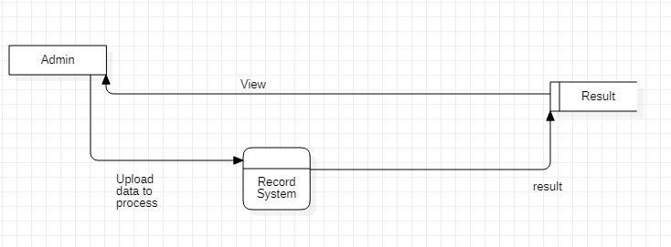
Project Design Data Flow Diagram Level 0

Slide 21
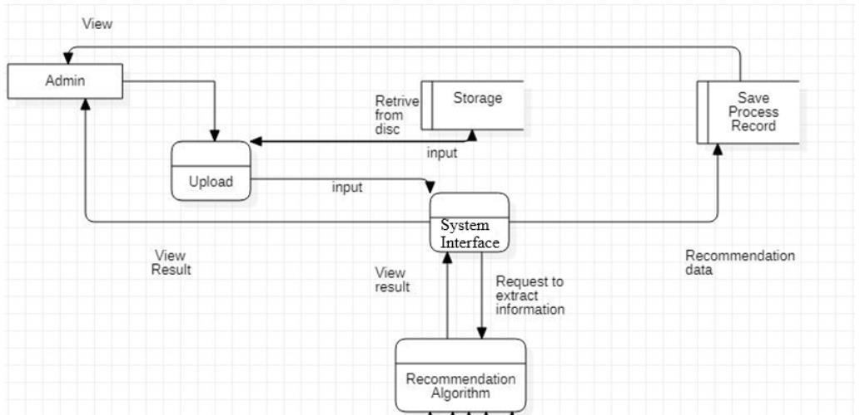
DFD Level 1

Slide 22
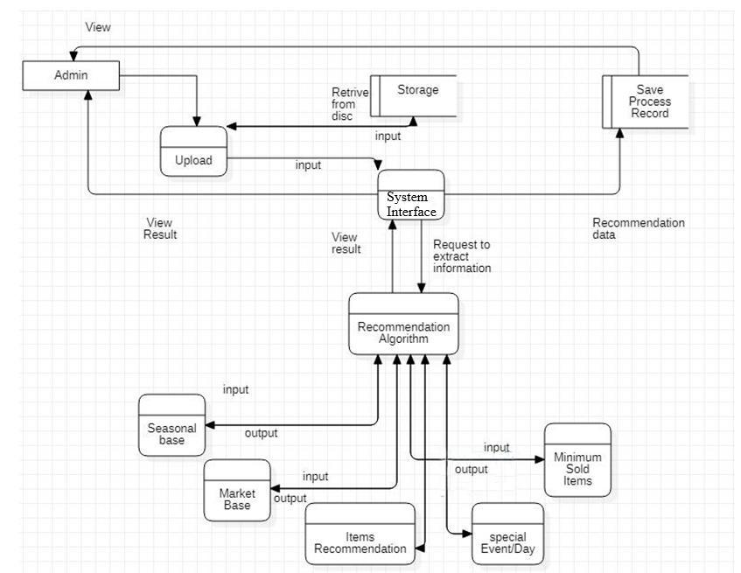
DFD Level 2

Slide 23
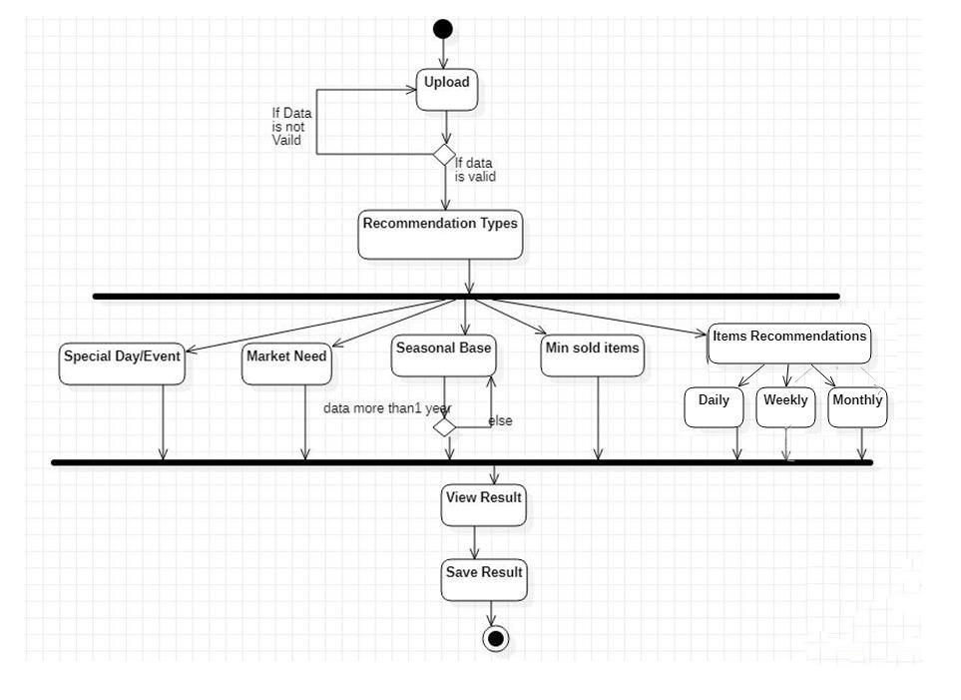
Activity Diagram

Slide 24
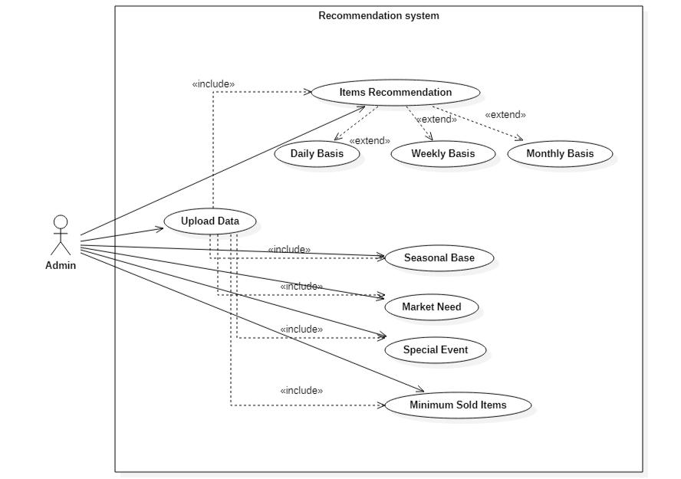
Use Case Diagram

Slide 25
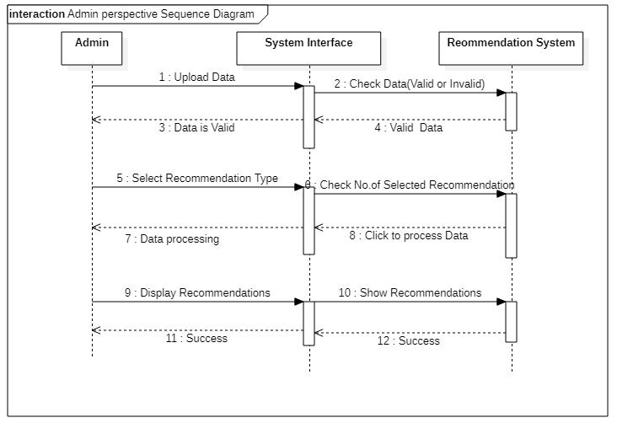
Sequence Diagram

Slide 26
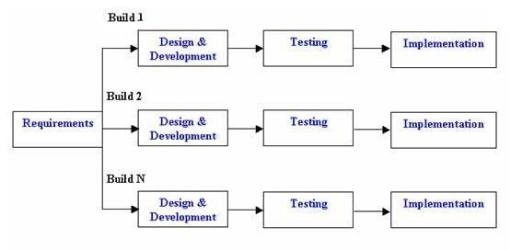
Implementation Diagram

Slide 27

Interface (for initialize the Setup)

Slide 28
Interface (after initialize setup)

Slide 29
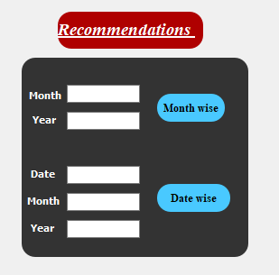
Interface Cont.….

Slide 30
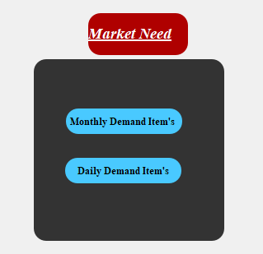
Interface Cont.….

Slide 31
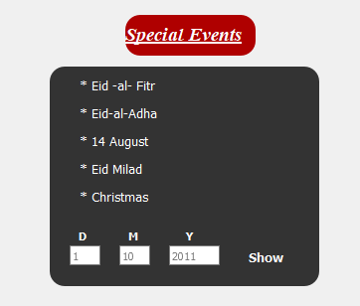
Interface Cont.….

Slide 32
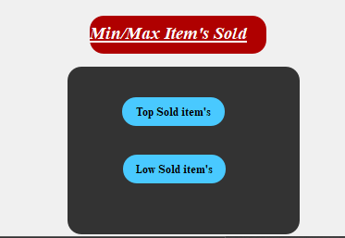
Interface Cont.….

Slide 33
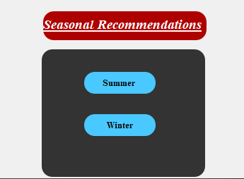
Interface Cont.….

Slide 34
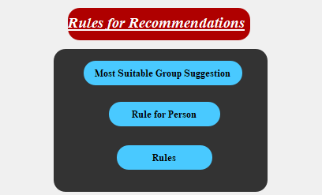
Interface Cont.….

Slide 35
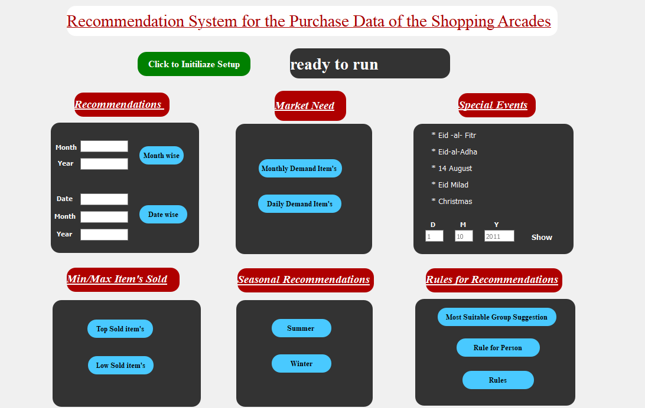
Main Interface

Slide 36
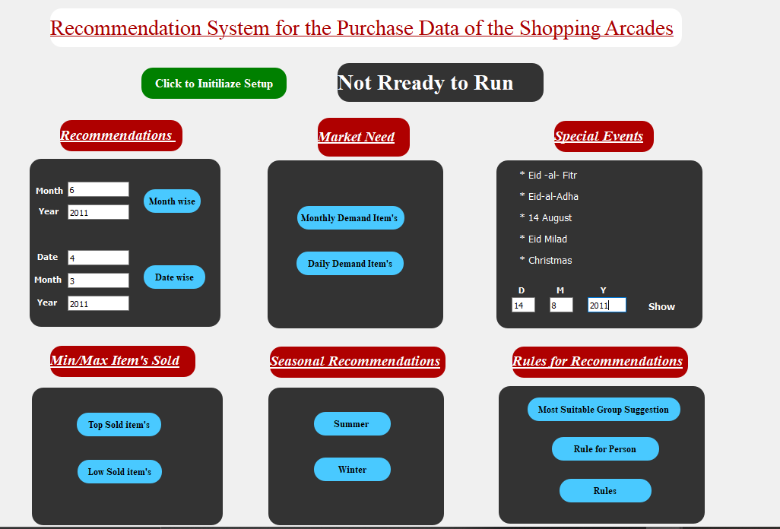
Interface (Input Phase)

Slide 37
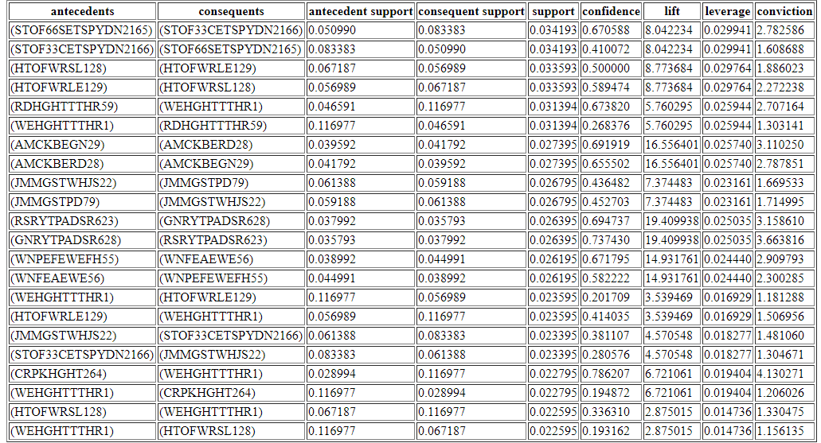
( Recommendation Screen)

Slide 38
Modern Tools
Anaconda
Jupiter Notebook
Qt Designer
Python
NSIS

Slide 39
Conclusion
After extensive research and testing, we have come to this conclusion. Of course, buying daily necessities from shopping malls is popular among Pakistanis. To save time and for the convenience of the people, it is important to keep the items in order.
Items that sell well at the same time should be arranged according to the needs of the people. Most people prefer large shopping malls because most items are necessarily available in one place. And with the availability of items, if the items are arranged in a better way, it also makes it easier for people and more items are likely to be sold..

Slide 40
Cont.…..
After this investigation, we understand that shopping malls have a huge role to play in Pakistan. And this industry has a lot of potential for growth as the number of shopping malls and the needs of the people are increasing day by day.

Slide 41
Future Work
ANDROID APP
In future we are going to launch an android app for our system to broaden the usage of our application. Because the usage of apps in becoming more and more convenient now a days and it also increases the portability and the extensibility of project.

Slide 42
References:
References
https://towardsdatascience.com/introduction-to-recommender-systems-6c66cf15ada [1]
http://rejoiner.com/resources/amazon-recommendations-secret-selling-online/#:~:text=Amazon%20currently%20uses%20item%2Dto,recommendation%20list%20for%20the%20user. [2]
https://www.kdnuggets.com/2019/08/order-matters-alibabas-transformer-based-recommender-system.html#:~:text=Ranking%20Candidates&text=The%20retrieval%20step%20used%20at,these%20candidates%20with%20high%20precision. [3]
https://www.kaggle.com/datasets [4]

Slide 43
Cont.…..
https://www.atlassian.com/software/jira/pricing?&aceid=&adposition=&adgroup=96100975406&campaign=9526674172&creative=423387260866&device=c&keyword=%2Bagile&matchtype=b&network=g&placement=&ds_kids=p52018286196&ds_e=GOOGLE&ds_eid=700000001558501&ds_e1=GOOGLE&gclid=CjwKCAjwx9_4BRAHEiwApAt0zi0sSjkgtqbaPDSysgI9znQfVuec0wRW2b_-Me6dfYtakq1j3cLMnxoCQpMQAvD_BwE&gclsrc=aw.ds [5]
https://www.datacamp.com/community/tutorials/recommender-systems-python?utm_source=adwords_ppc&utm_campaignid=1455363063&utm_adgroupid=65083631748&utm_device=c&utm_keyword=&utm_matchtype=b&utm_network=g&utm_adpostion=&utm_creative=278443377095&utm_targetid=aud-517318242147:dsa-473406569915&utm_loc_interest_ms=&utm_loc_physical_ms=9075152&gclid=CjwKCAjwx9_4BRAHEiwApAt0zsKpenq8GlzxhM3ENptyjIWO9x1Kxr48Wrp-PrSNR1nZpK11kTqbhBoCDR0QAvD_BwE [6]
https://www.researchgate.net/publication/319271789_Family_Shopping_Recommendation_System_Using_User_Profile_and_Behavior_Data/fulltext/599f9a340f7e9b3639fe2634/Family-Shopping-Recommendation-System-Using-User-Profile-and-Behavior-Data.pdf [7]

Slide 44


